Slide 1
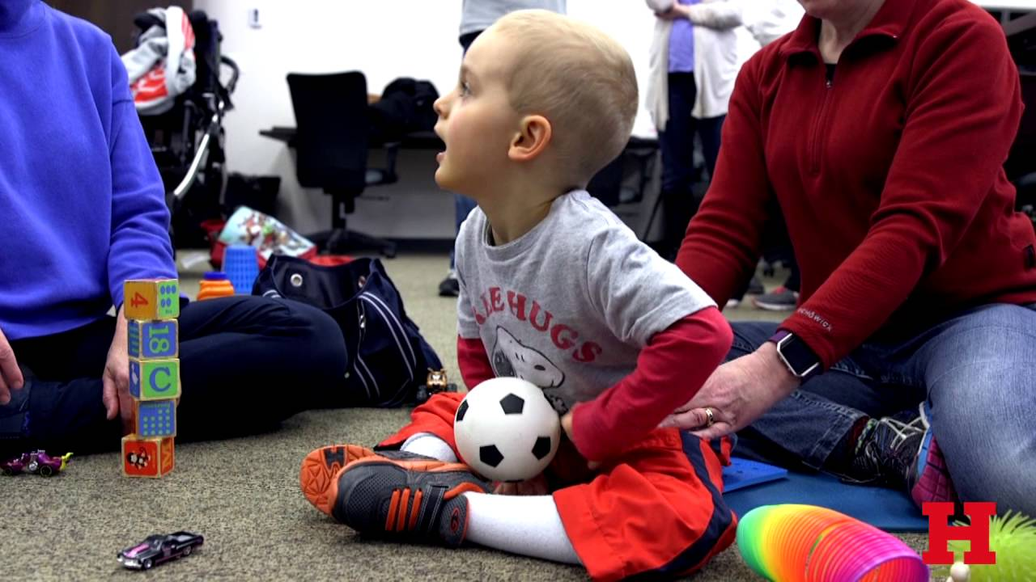

CEREBRAL PALSY

Slide 2
Objectives
At the end of the session,
Will understand & define the paediatric age group from birth.
Introduction to Cerebral palsy.
Early identification of CP & it’s importance.
Age appropriate measures & treatment strategies available for CP upto 3 years.

Slide 3
Paediatric age group
Neonates
Infancy
Toddler
Pre school
Schoolers
Teen
Young
Adults
https://www.healthychildren.org/english/ages-stages/pages/default.aspx

Slide 4
Introduction to Cerebral palsy
History & terminology:
Sir William Little called as Little’s disease
He attributed CP mainly due to perinatal events & abnormal birth process
Sir William Osler ( 1849-1919) Coined the term Cerebral Palsy.
Sigmund Freud description is so complete that it remains as relevant in 2014 as it was at the end of 19th century.
Dr. Winthrop Phelp CP & birth injuries.

Slide 5
Definition
Cerebral palsy is a non progressive but often changing, motor impairment syndromes which are secondary to lesions in the immature brain.
Motor disorder may progress & may be accompanied by disorders of sensation, cognitive, behavioural and systemic disorders.
Finally all together may led to functional disability.

Slide 6
ICF and cerebral Palsy
Body structure | Body function | Activity & Participation
Structure of Lower extremity Structure of upper extremity Structure of trunk Other musculoskeletal structures related to movement | Neuro muscular & movement related functions Control of voluntary movement Sensation of pain Gait pattern | Recreation & leisure Self care Walking Mobility

Slide 7
Management of Cerebral palsy requires,
Knowledge motor control development.
Principles of neural plasticity.

Slide 8
Theories of Motor Control
Reflex theory (Sherrington) movement was the result of a stimulus.
Hierarchical theory (Hughlings Jackson) assumption that the CNS is organized into three primary levels of control: high, middle, and low centers.
Dynamic action theory ( Kamm, Kelso) movement is from both physical & neural components.

Slide 9
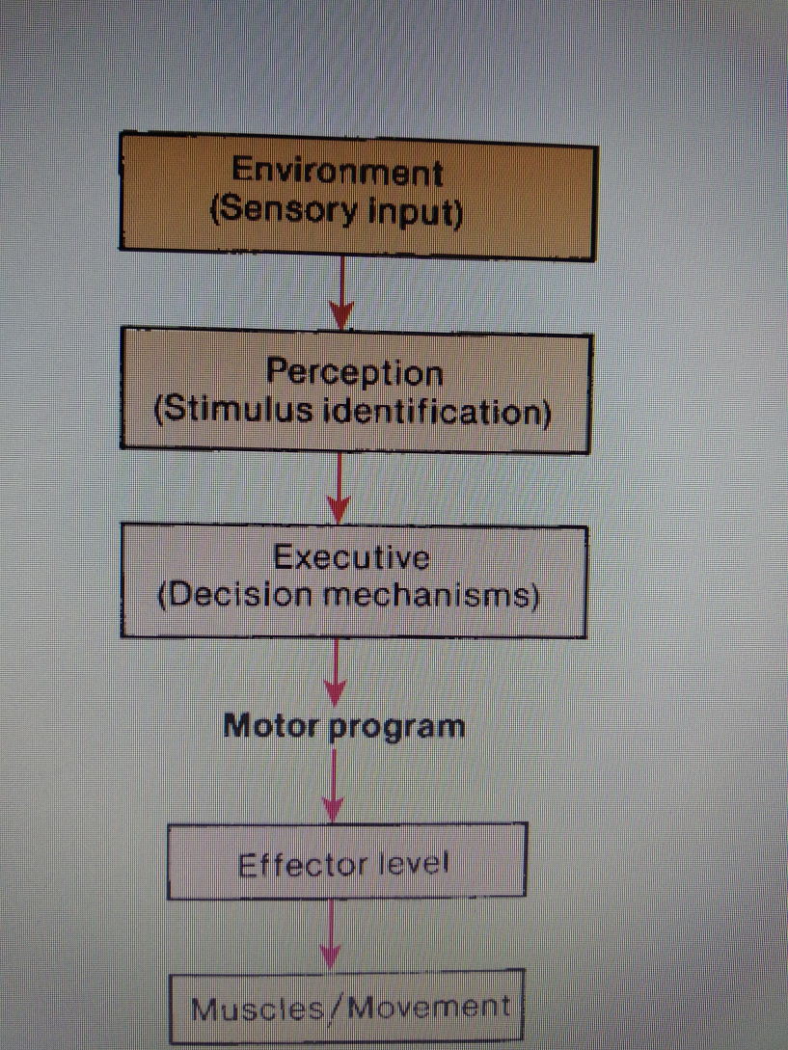
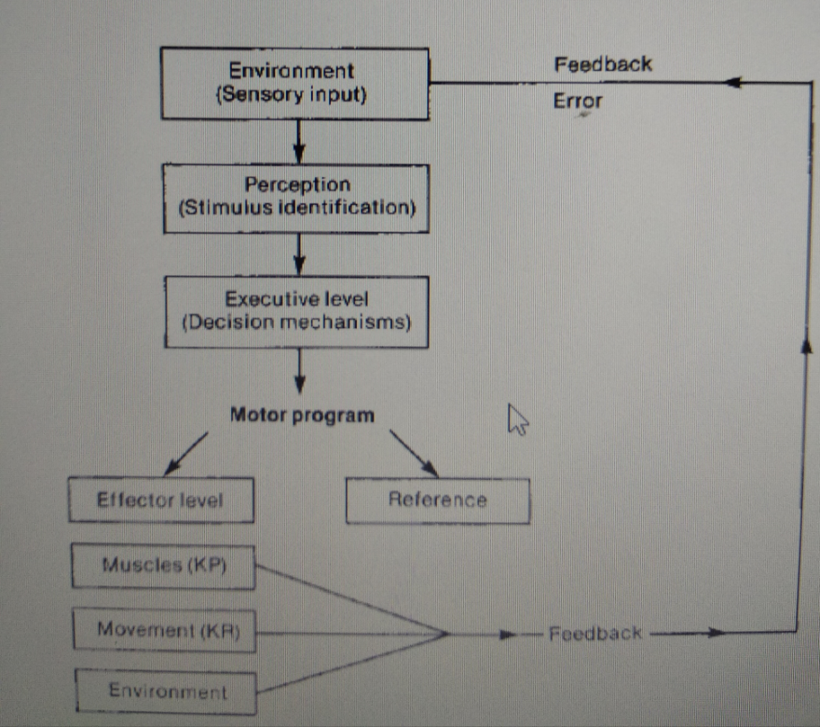
Motor Programming Theory

Slide 10

Activity

Slide 11
https://www.youtube.com/watch?v=5u2sLAznhnY

Slide 12
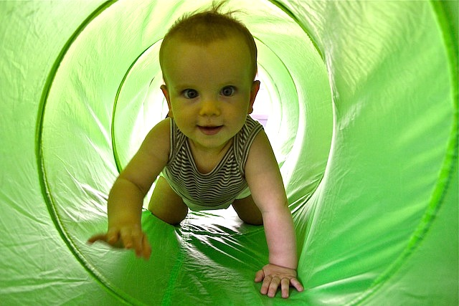
Assessment - InFANCY

Slide 13
General movement assessment by Prechtl – endogenously generated motor activity may be better indicator of the integrity of motor function rather than examination based on reactivity to stimulus. ( Prechtl, 1989)
GM’s involves the whole body in a variable sequence of arm, leg, neck and trunk movements.

Slide 14
NORMAL & ABNORMAL GM’s
Normal
Abnormal
Writhing Fidgety
Continual Intermittent Sporadic
Poor-
Repertoire
Cramped – Synchronised
Chaotic
Absent fidgety

Slide 15
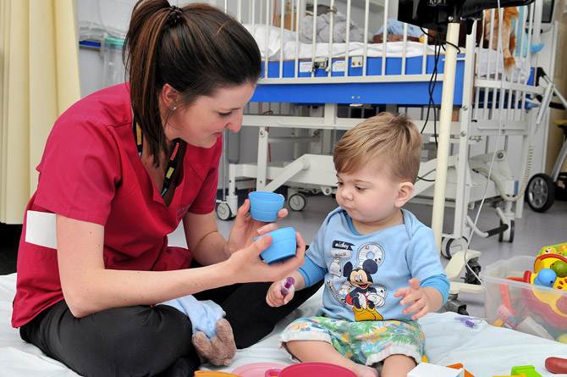
ASSESSMENT - TODDLER

Slide 16
Gross motor functional classification system (GMFCS).
Manual ability classification system (MACS).
Communication function classification system (CFCS).
Gross motor function measure (GMFM -66).

Slide 17
GMFCS – Before 2 YEARS
LEVEL I: Infants move in and out of sitting and floor sit with both hands free to manipulate objects. Infants crawl on hands and knees, pull to stand and take steps holding on to furniture. Infants walk between 18 months and 2 years of age without the need for any assistive mobility device.
LEVEL II: Infants maintain floor sitting but may need to use their hands for support to maintain balance. Infants creep on their stomach or crawl on hands and knees. Infants may pull to stand and take steps holding on to furniture.
.

Slide 18
LEVEL III: Infants maintain floor sitting when the low back is supported. Infants roll and creep forward on their stomachs.
LEVEL IV: Infants have head control but trunk support is required for floor sitting. Infants can roll to supine and may roll to prone.
LEVEL V: Physical impairments limit voluntary control of movement. Infants are unable to maintain antigravity head and trunk postures in prone and sitting. Infants require adult assistance to roll.

Slide 19
GMFCS – BETWEEN 2ND AND 4TH BIRTHDAY
LEVEL I: Children floor sit with both hands free to manipulate objects. Movements in and out of floor sitting and standing are performed without adult assistance. Children walk as the preferred method of mobility without the need for any assistive mobility device.
LEVEL II: Children floor sit but may have difficulty with balance when both hands are free to manipulate objects. Movements in and out of sitting are performed without adult assistance. Children pull to stand on a stable surface. Children crawl on hands and knees with a reciprocal pattern, cruise holding onto furniture and walk using an assistive mobility device as preferred methods of mobility.

Slide 20
LEVEL III: Children maintain floor sitting often by "W-sitting" (sitting between flexed and internally rotated hips and knees) and may require adult assistance to assume sitting. Children creep on their stomach or crawl on hands and knees (often without reciprocal leg movements) as their primary methods of self-mobility. Children may pull to stand on a stable surface and cruise short distances. Children may walk short distances indoors using a hand-held mobility device (walker) and adult assistance for steering and turning.

Slide 21
LEVEL IV: Children floor sit when placed, but are unable to maintain alignment and balance without use of their hands for support. Children frequently require adaptive equipment for sitting and standing. Self-mobility for short distances (within a room) is achieved through rolling, creeping on stomach, or crawling on hands and knees without reciprocal leg movement.

Slide 22
LEVEL V: Physical impairments restrict voluntary control of movement and the ability to maintain antigravity head and trunk postures. All areas of motor function are limited. Functional limitations in sitting and standing are not fully compensated for through the use of adaptive equipment and assistive technology. At Level V, children have no means of independent movement and are transported. Some children achieve self-mobility using a powered wheelchair with extensive adaptations.

Slide 23
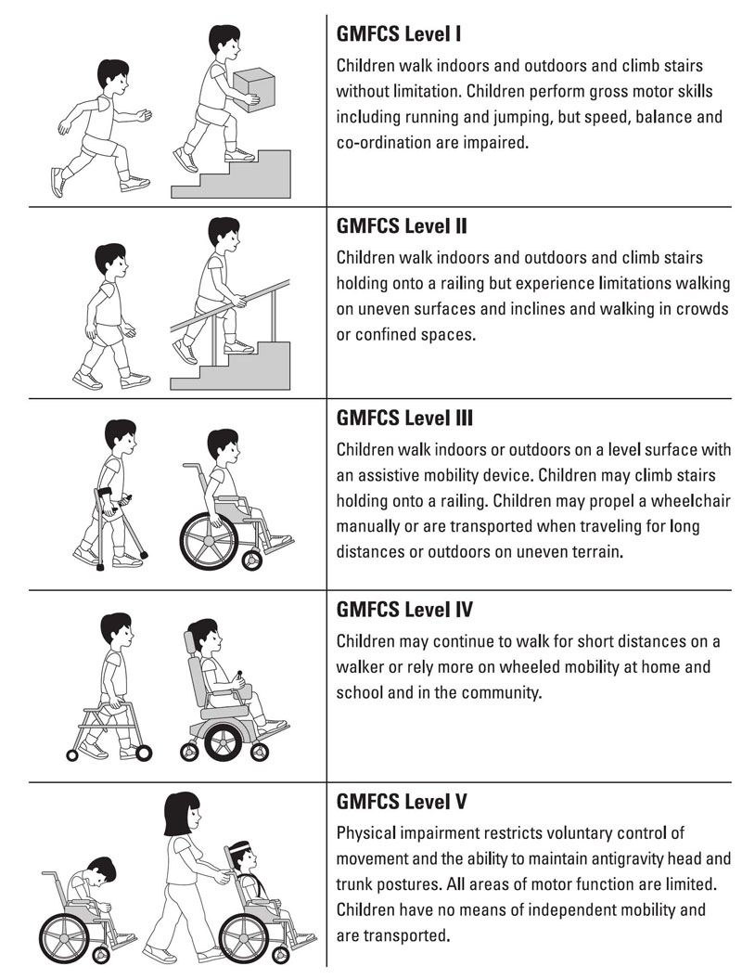
GMFCS

Slide 24


Slide 25
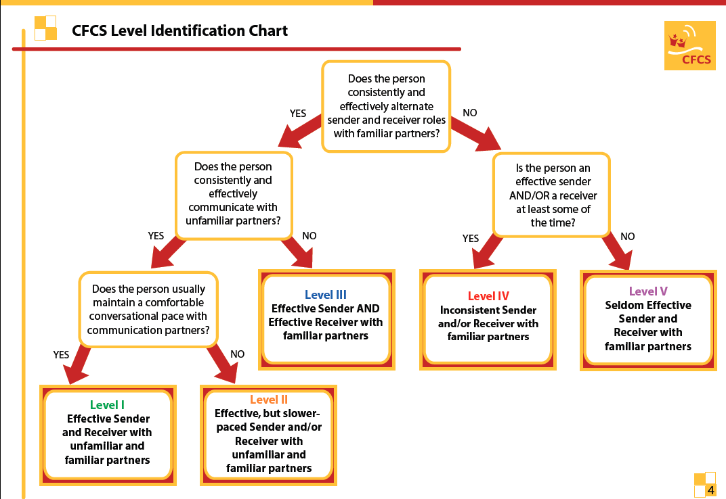
CFCS

Slide 26
MACS
I - Handles objects easily and successfully.
II - Handles most objects but with somewhat reduced quality and/or speed of achievement.
III - Handles objects with difficulty; needs help to prepare and/or modify activities.
IV - Handles a limited selection of easily managed objects in adapted situations.
V - Does not handle objects and has severely limited ability to perform even simple actions

Slide 27


Slide 28


